Slide 1
Convolutional Neural Network (CNN)
Bakul Gohel, Ph.D.
DA-IICT, Gandhinagar

Slide 2
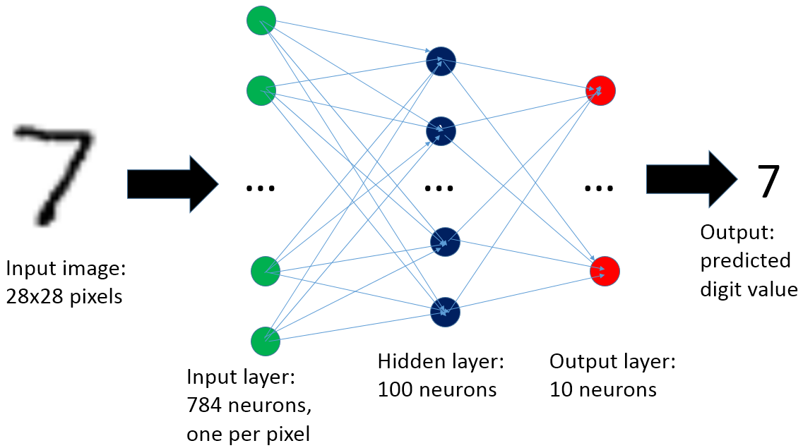
IMAGE CLASSIFICAION with ANN
https://3.bp.blogspot.com/-mDyzBzA4btg/V4_Z0f2mc7I/AAAAAAAAE3M/dtU8hT661fQWtnRC_JvIH_4qifQomZ4PACLcB/s1600/MNIST_neuralnet_image.png

Slide 3
IMAGE CLASSIFICAION with ANN
Image classification with ANN
Features are pre-defined
IMAGE
Feature Extraction
ANN
MLP
Classification/
Regression

Slide 4
Convolutional Neural Network (CNN)

Slide 5
Convolution Neural Network
Concept of CNN came in 1980s as a Neocognitron neural network architecture
It is inspired by concept of receptive fields and visual information processing in retina and brain.
Neocognitron later inspired CNN
Gradually CNN model evolved and improved over a time
Deep learning boom happen in the last decade, and CNN is the important part of many deep learning architectures

Slide 6
CNN concept
It is for image…
CNN is claimed to be partly inspired by visual information processing in the brain e.g. feature extraction, feature integration and semantic decoding
CNN also involves some form of image processing operations

Slide 7
Image Processing

Slide 8
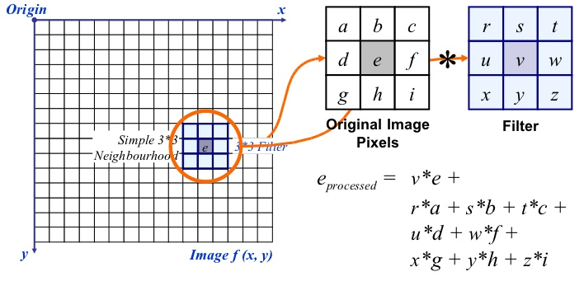
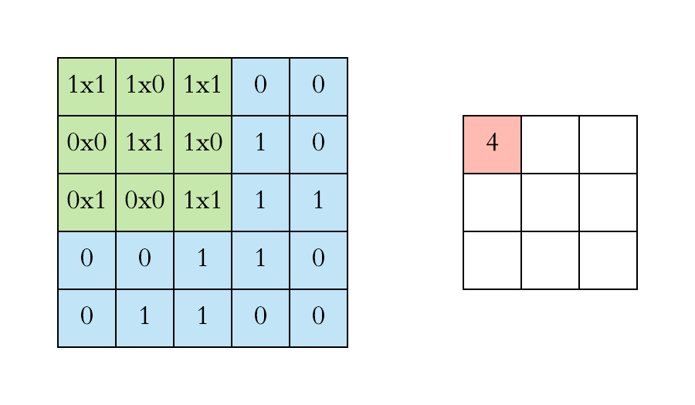
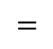
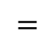

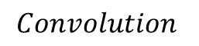
Image Processing – spatial filtering
1 | 1 | 1 | 0 | 0
0 | 1 | 1 | 1 | 0
0 | 0 | 1 | 1 | 1
0 | 0 | 1 | 1 | 0
0 | 1 | 1 | 0 | 0
1 | 0 | 1
0 | 1 | 0
1 | 0 | 1
$$∗$$
$$=$$
$$=$$
image
filter / kernel
$$Convolution$$

Slide 9
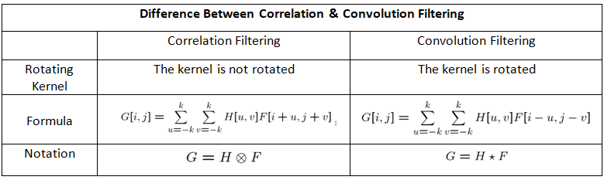
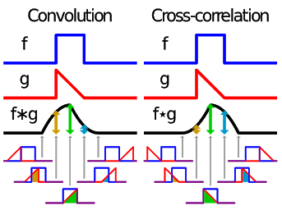
Image Processing – spatial filtering
Source: https://miro.medium.com/max/779/1*sMQtFEhhraUEjEtrbMO1ag.png
CNN, in facts uses correlation operation
In CNN, convolution term used instead of correlation
As the kernel or filter to be learned from the data; performing convolution or correlation does not make the difference
Source: https://i.stack.imgur.com/nGZQ1.png

Slide 10
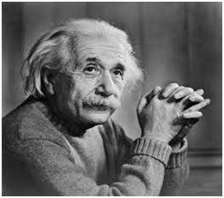
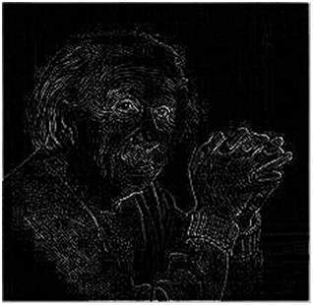
Image Processing – spatial filtering
High pass filter
Laplacian filter
Source :Digital image processing by Gonzales and woods 3th Edi.

Slide 11
Image Processing – spatial filtering
Low pass filter
Simple average filter
Gaussian filter
It induce bluring
Source :Digital image processing by Gonzales and woods 3th Edi.

Slide 12
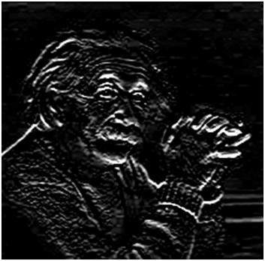

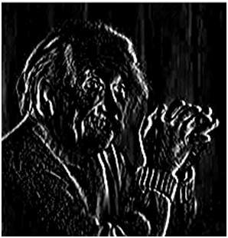
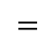


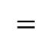
Image Processing – spatial filtering
High pass filter
$$∗$$
$$=$$
$$∗$$
$$=$$
Source : https://www.tutorialspoint.com/dip/sobel_operator.htm

Slide 13
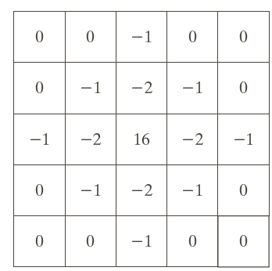
High pass filter
Laplacian filter
Laplacian of Gaussian filter
=Laplacian*Gaussian filter
Different properties/features from image can be extracted by applying different filters/kernals (filters bank) to the image
We can design and generate such filters bank specific to our application
Source :Digital image processing by Gonzales and woods 3th Edi.

Slide 14
Visual information processing in brain

Slide 15
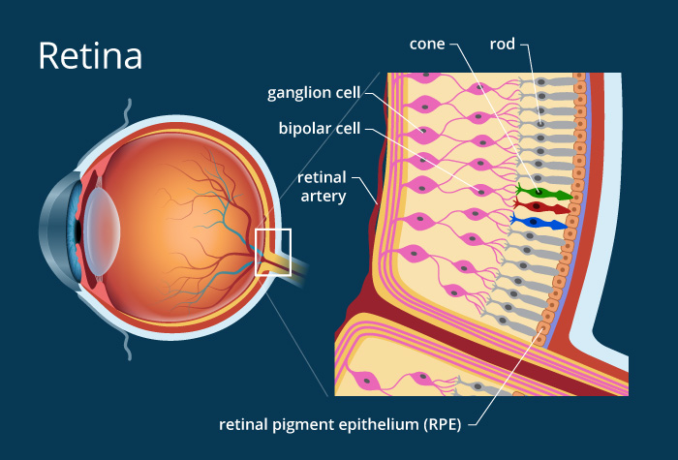
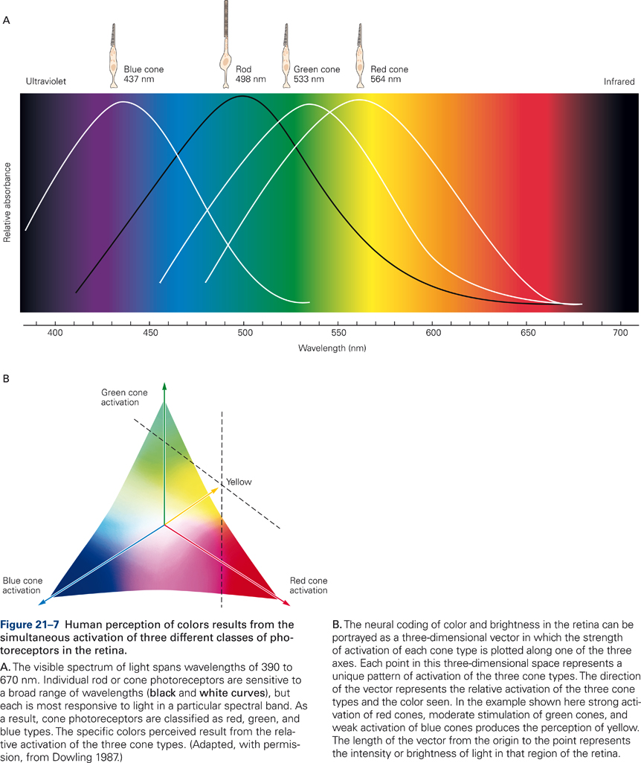

Vision

Slide 16
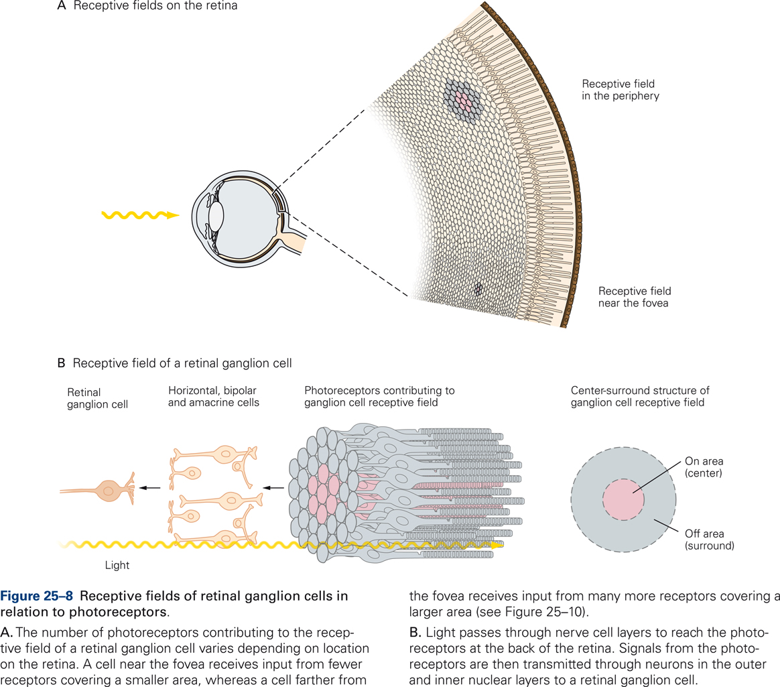
Receptive field
Source :Principles of Neural Science by Kandel et. al. 5th Edi.

Slide 17
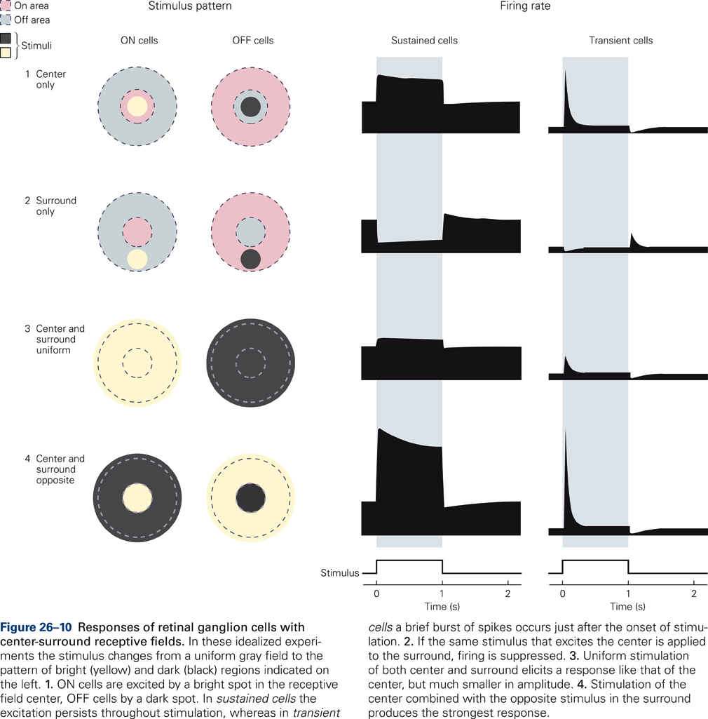
Receptive field
Source :Principles of Neural Science by Kandel et. al. 5th Edi.

Slide 18
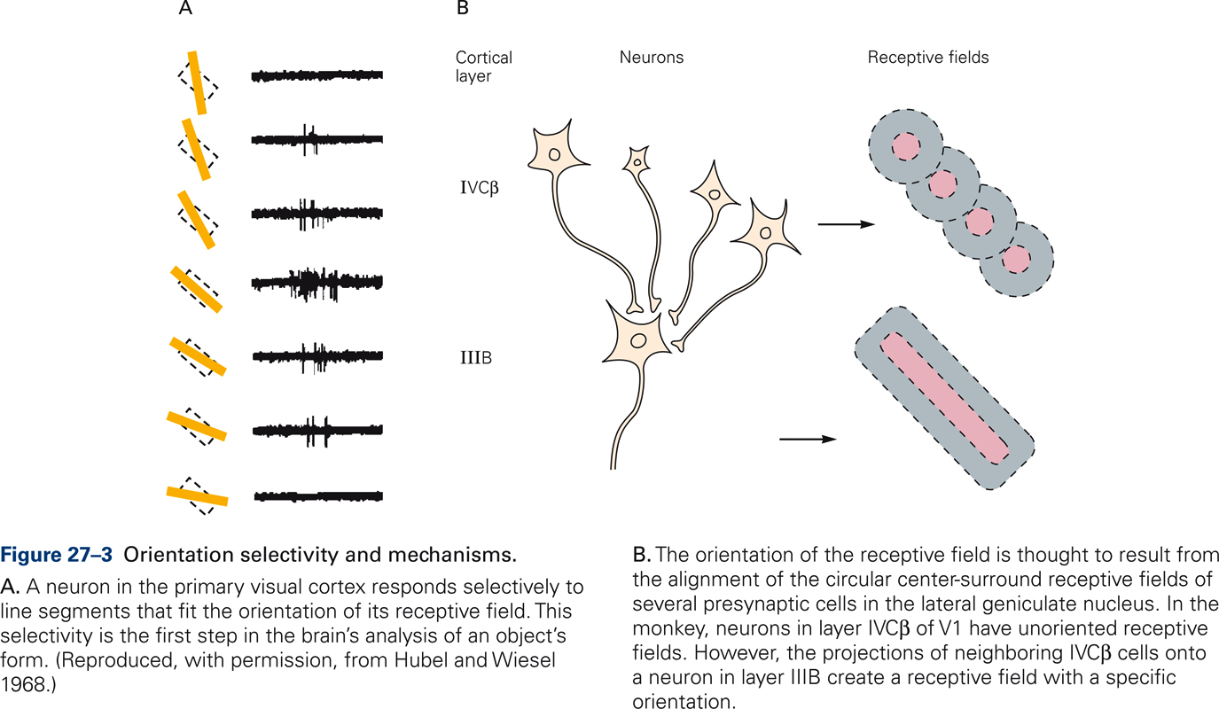
Hierarchical visual information processing
Source :Principles of Neural Science by Kandel et. al. 5th Edi.

Slide 19
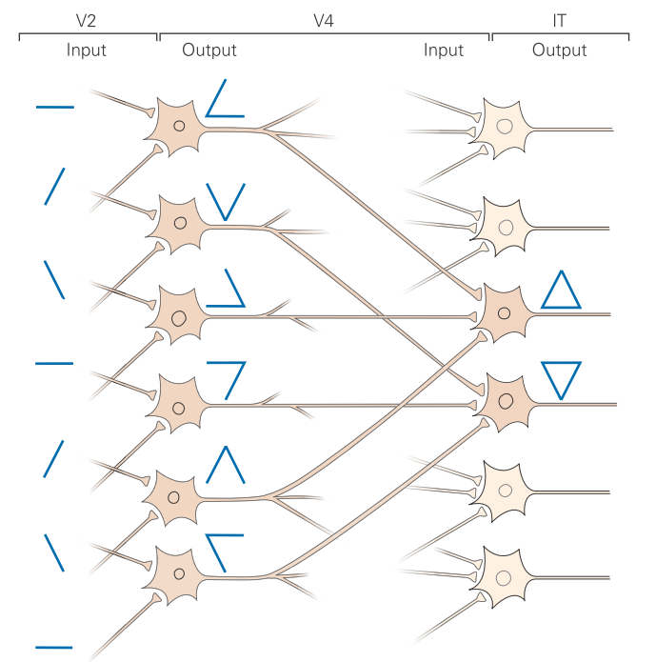
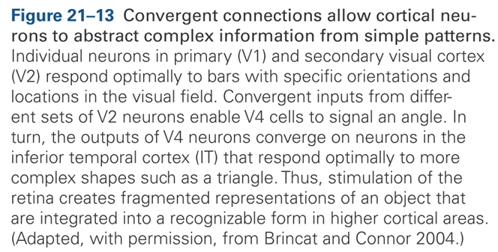
Hierarchical visual information processing
Source :Principles of Neural Science by Kandel et. al. 5th Edi.

Slide 20
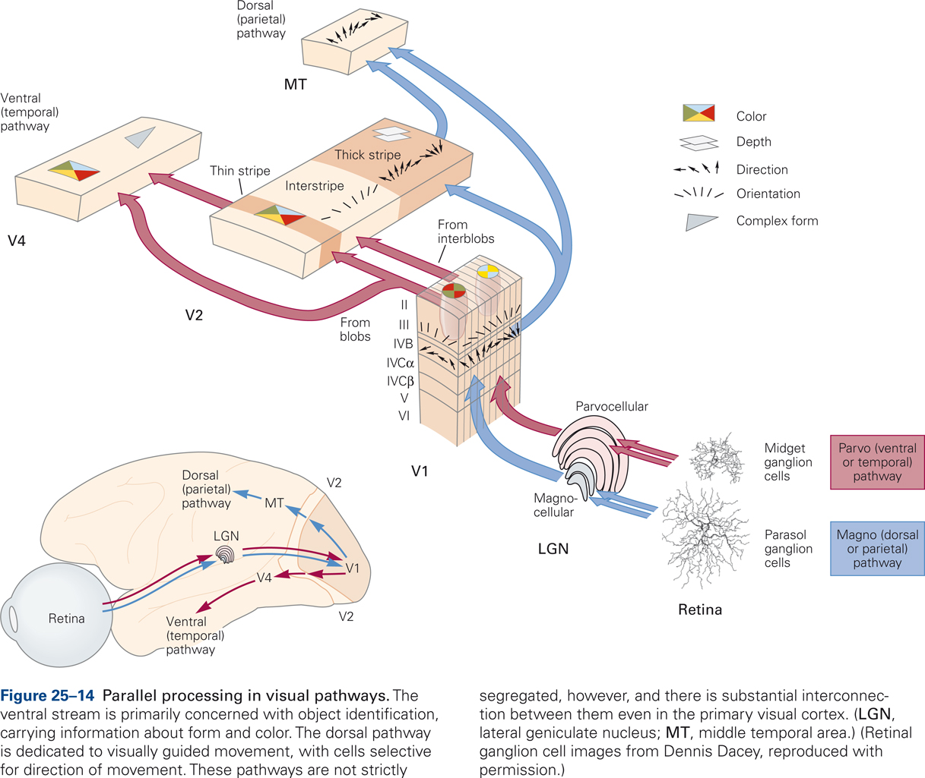
Hierarchical visual information processing
Source :Principles of Neural Science by Kandel et. al. 5th Edi.

Slide 21
CNN concept
Image classification with ANN
Features are pre-defined
Feature Extraction
IMAGE
ANN
MLP
Classification/
Regression
Feature Extraction
Image classification with CNN
Learn the features from data

Slide 22
CNN ARCHITECTURE

Slide 23

CNN ARCHITECUTRE
Convolution Layers
https://cdn-images-1.medium.com/max/1600/1*XbuW8WuRrAY5pC4t-9DZAQ.jpeg

Slide 24
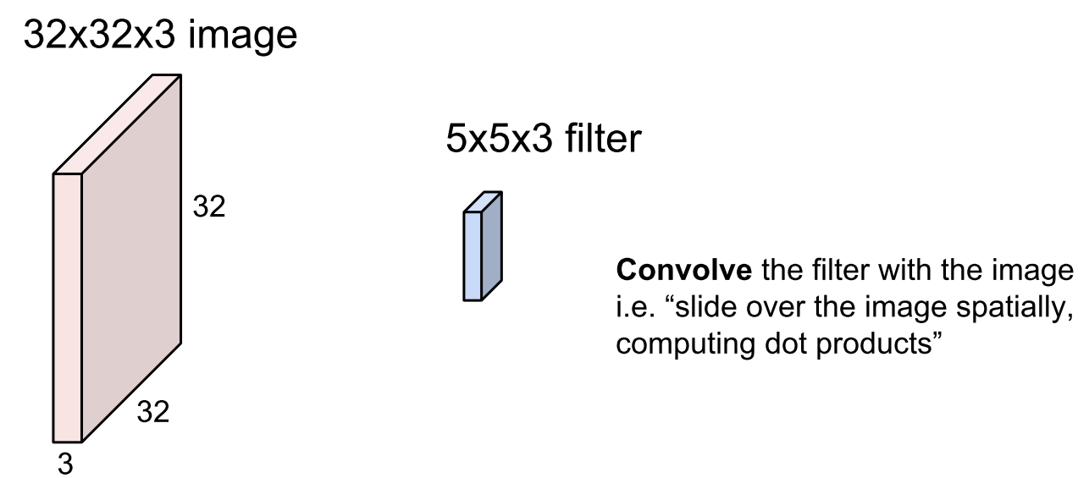
CONVOLUTION LAYER
Content credit : Fei-Fei Li & Justin Johnson & Serena Yeung

Slide 25
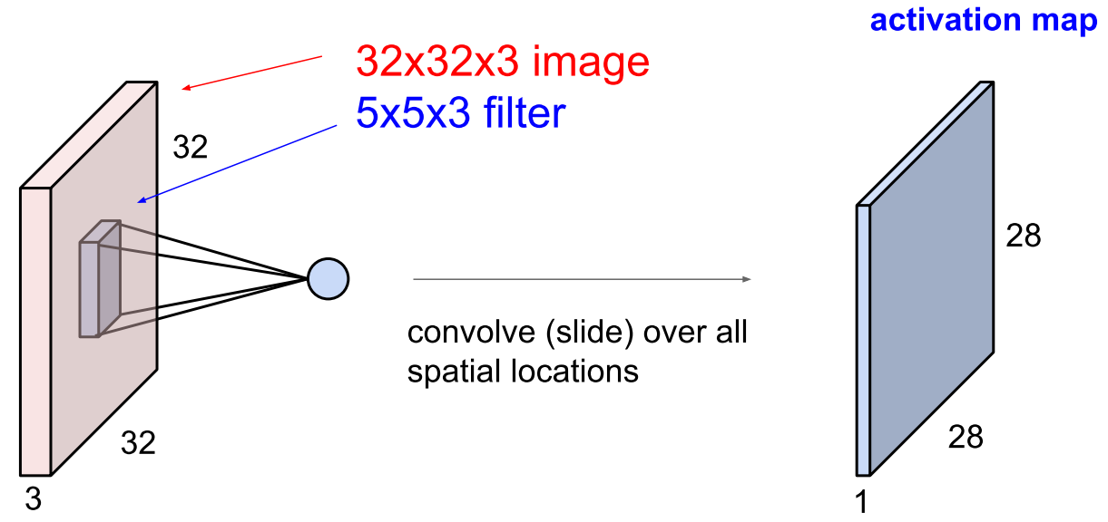
CONVOLUTION LAYER
Content credit : Fei-Fei Li & Justin Johnson & Serena Yeung

Slide 26
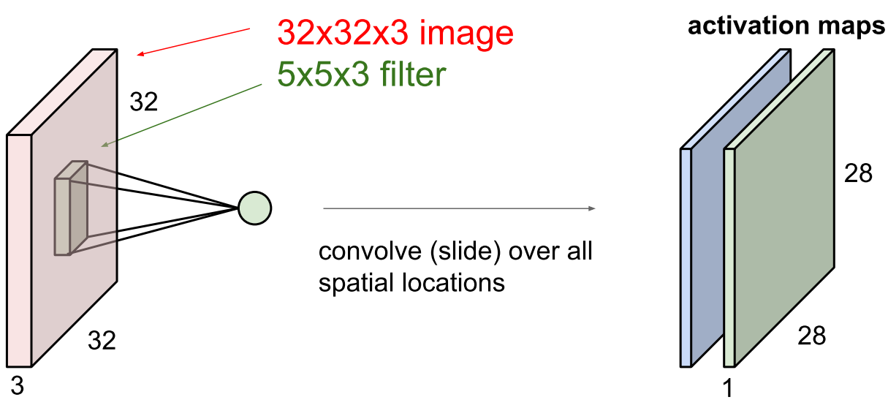
CONVOLUTION LAYER

Slide 27
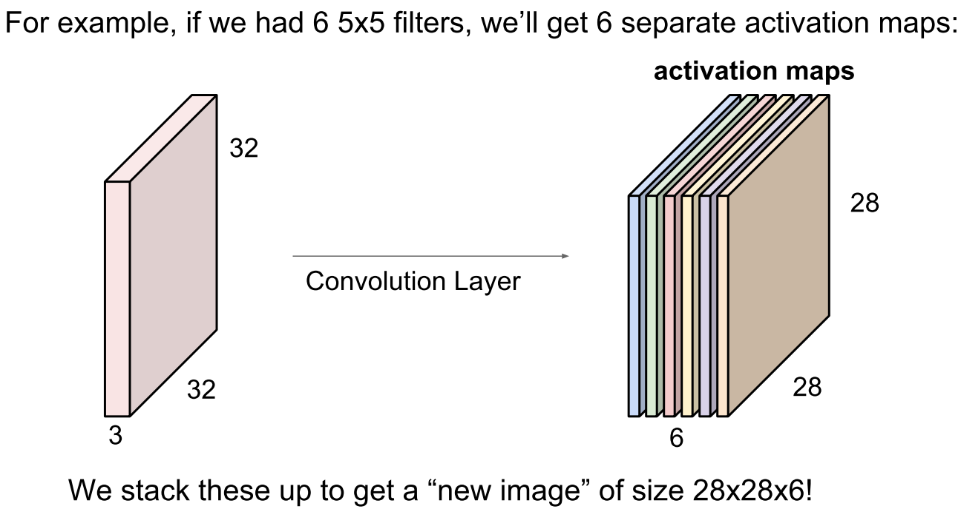
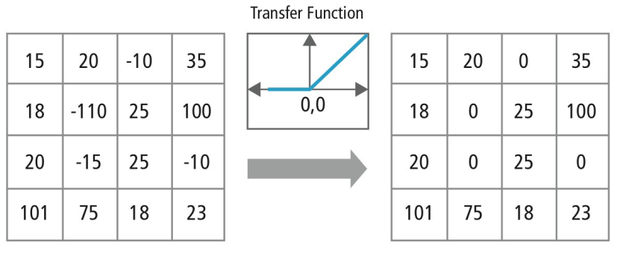
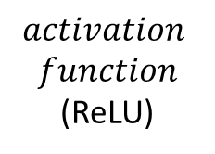
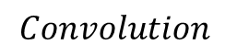
CONVOLUTION LAYER
$$Convolution$$
$$activation$$
$$function$$
(ReLU)

Slide 28
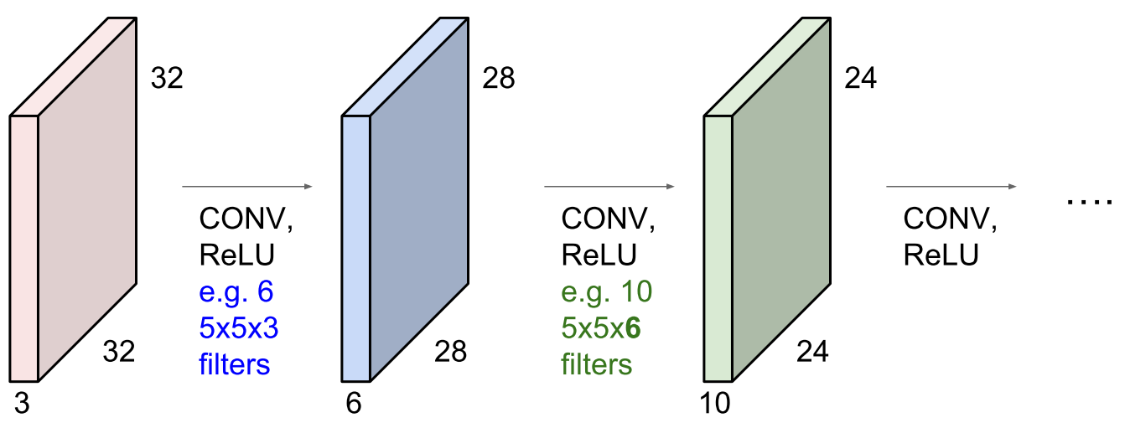
CONVOLUTION LAYER

Slide 29
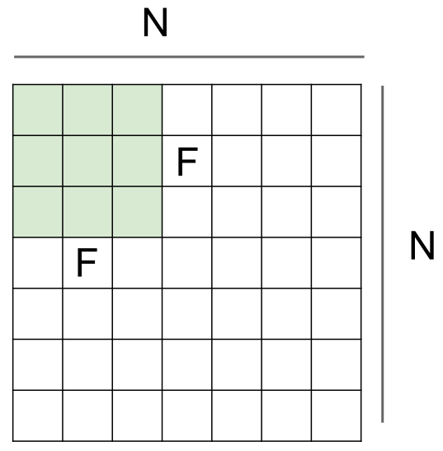
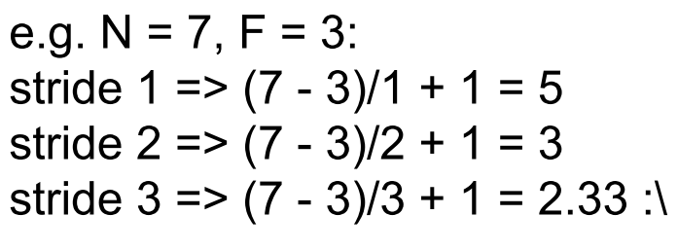
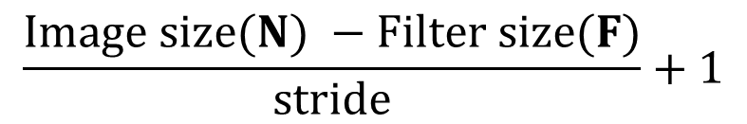
CONVOLUTION LAYER
$$\frac{Image size(N) −Filter size(F)}{stride}+1$$

Slide 30
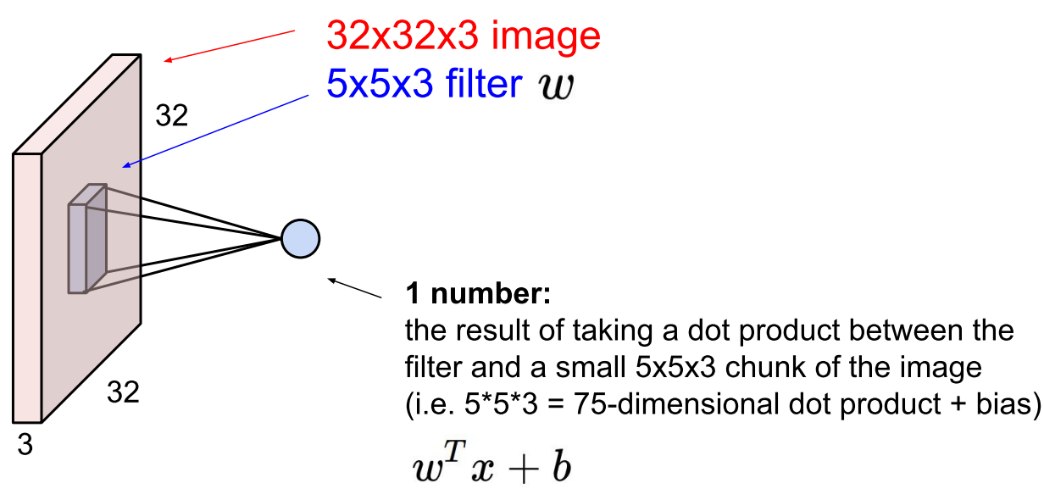
CONVOLUTION LAYER

Slide 31
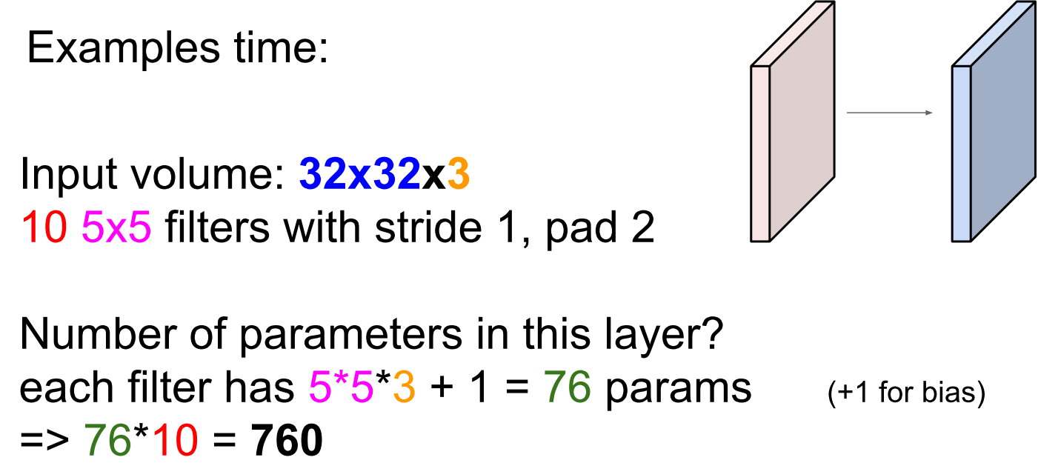
CONVOLUTION LAYER

Slide 32
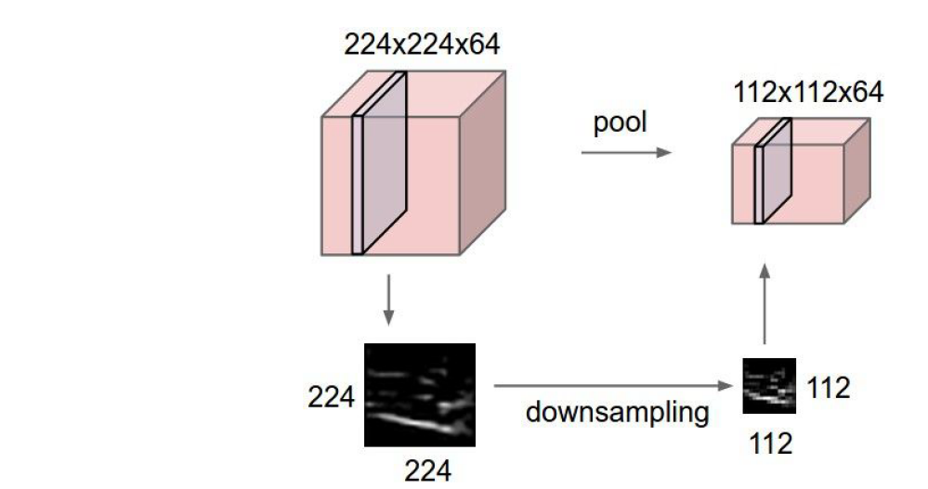
POOLING LAYER
- Makes the representations smaller and more manageable
- Operates over each activation map independently

Slide 33
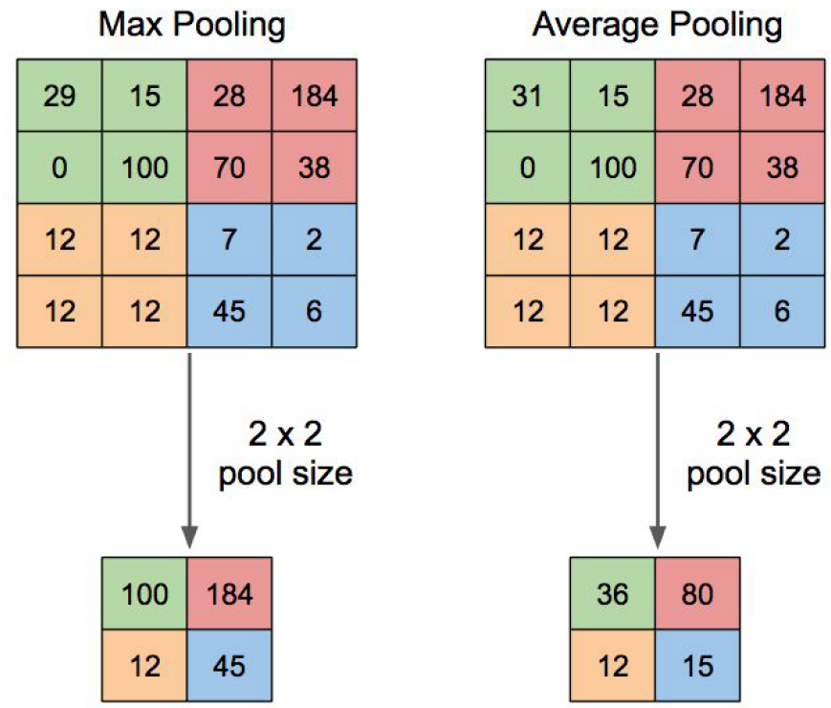
POOLING LAYER
Limited local shift invariance property…

Slide 34
CONVOLUTION LAYER
https://cdn-images-1.medium.com/max/1600/1*XbuW8WuRrAY5pC4t-9DZAQ.jpeg
Convolution leverages two important ideas: local connectivity, and parameter sharing

Slide 35
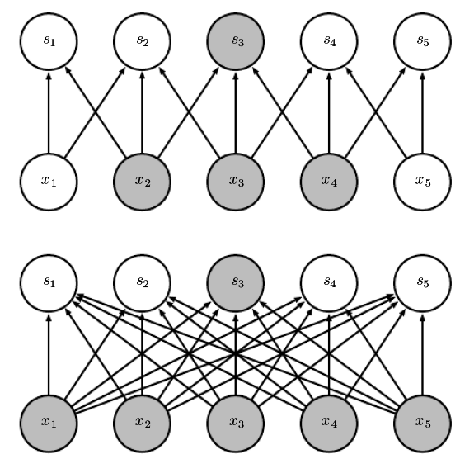
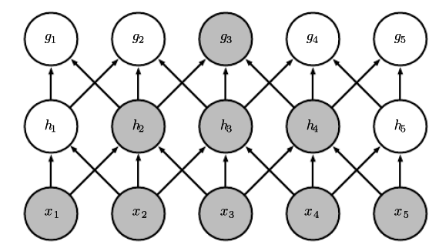
CNN vs ANN
local connectivity
CNN
Locally Connected
ANN/MLP
Fully Connected
CNN
Receptive Field

Slide 36
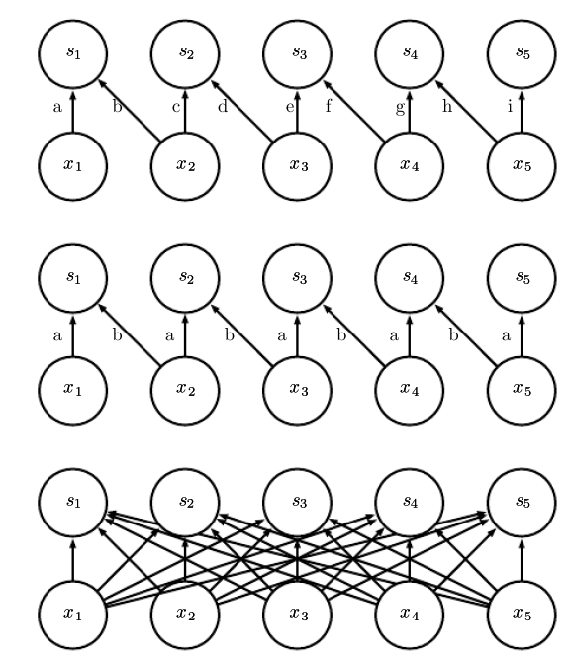
CNN vs ANN
Parameter sharing
Locally Connected
No Parameter sharing
CNN
Locally Connected
Parameter shared(filter)
Fully Connected
No Parameter sharing

Slide 37
ANN block for classification
ANN Block
Apply similar concepts and rules as of ANN

Slide 38
CNN Learning
Error Back-propogation
Similar to ANN

Slide 39
CNN concept
Image classification with ANN
Features are pre-defined
Feature Extraction
IMAGE
ANN
MLP
Classification/
Regression
Feature Extraction
Image classification with CNN
Learn the features from data

Slide 40
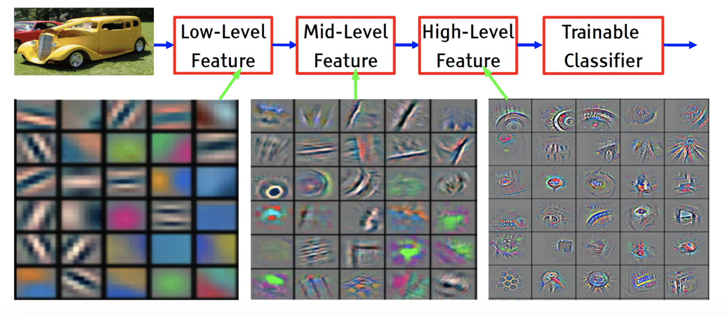
How CNN concept or Deep Learning works ?
In view of information processing
Conceptually it is also true for ANN….
I am not agree with this concept..

